Slide 1






TOPIC: DIABETES RISK PREDICTION USING MULTI-LAYER PERCEPTRON (MLP) WITH ADVANCED OPTIMIZATION TECHNIQUES
Dinh Ngoc Dung - 2201140017
Bui Minh Quan - 2201140070
Nguyen Khoa Dang - 2201140022

Slide 2
TABLE OF CONTENTS
Formulate / Outline the Problem
Identify Inputs and Outputs
Prepare Data: Inspecting & Visualizing
Optimization Techniques Applied
Neural Network Model Specification
Performance Measurement
Inference on New Data
Conclusion

Slide 3

1.FORMULATE / OUTLINE THE PROBLEM
Context:
Diabetes is a chronic disease with severe complications. Early detection is critical.
Dataset: CDC Diabetes Health Indicators Dataset
Core Challenge:
Imbalanced Data: The dataset is heavily skewed (~84% healthy, ~16% diabetic).
Standard models favor the majority class, leading to high accuracy but low sensitivity (missing actual patients)
Objective:
Build a Feedforward Neural Network (MLP).
Apply optimization techniques to maximize Recall (catching the disease).
Key Definitions:
• Binary Classification: A task where the model predicts one of two classes (e.g., Healthy vs. Sick).
Imbalanced Dataset: A dataset where one class (Healthy) significantly outnumbers the other (Diabetic), causing bias.

Slide 4


2. IDENTIFY INPUTS AND OUTPUTS
Input (21 features)
Demographics: Age (13 levels), Sex(Male/female), Education(1-6), Income(1-8).
Health Indicators: HighBP, HighChol, Cholcheck (Cholesterol check in 5 years), BMI(Body mass index), Stroke, HeartDiseaseorAttack
Lifestyle: Smoker, Physical Activity, Alcohol Consumption, Diet (Fruits/Veggies).
General Health: GenHlth (Self-rated health 1-5), MentHlth (Days of poor mental health), PhysHlth (Days of poor physical health), DiffWalk (Difficulty walking).
Healthcare Access: AnyHealthcare (Has coverage), NoDocbcCost (Skipped doctor due to cost).
Output (Target Variable):
Target Variable: Diabetes_binary
Original Classes: 0 (No Diabetes), 1 (Prediabetes), 2 (Diabetes).
Transformed Classes: map to a Binary Classification problem:
- Class 0: No Diabetes.
- Class 1: At Risk (combining Prediabetes + Diabetes).

Slide 5
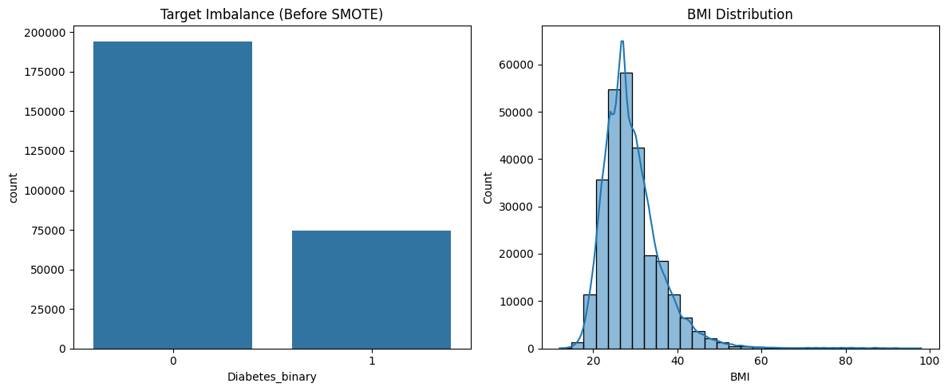
3. PREPARE DATA: INSPECTING AND VISUALIZING
Data Inspection & Cleaning:
Loaded ~269,000 samples
Removed missing values (NaN) and irrelevant columns (ID).
Preprocessing:
Splitting: 80% Training Data / 20% Test Data (Stratified).
Scaling: Used StandardScaler to normalize features (e.g., bringing Age and BMI to the same scale).
Target Mapping
Merged Class 1 (Prediabetes) and Class 2 (Diabetes)

Slide 6


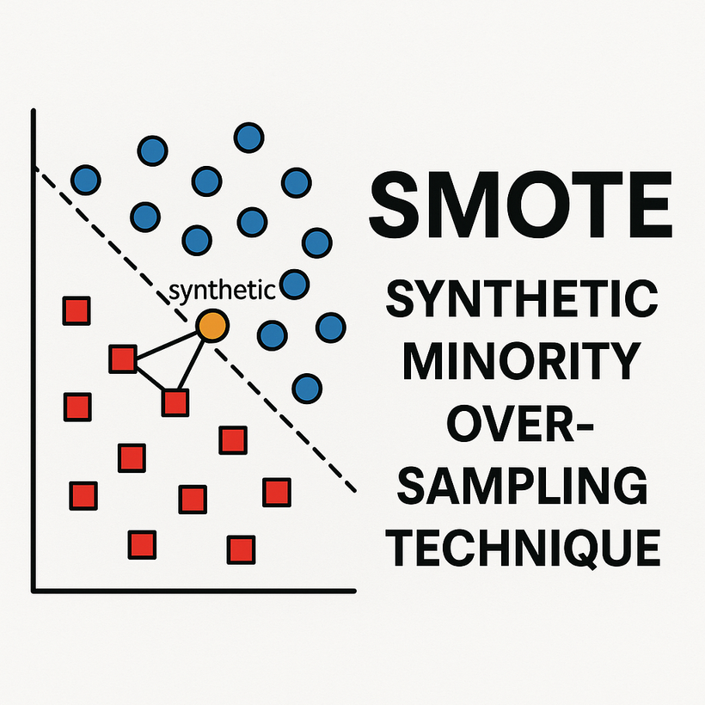


4. OPTIMIZATION TECHNIQUES
DATA LEVEL: SMOTE
THE PROBLEM:
The dataset is heavily imbalanced (~84% Healthy vs. ~16% Diabetic). Standard models ignore the minority class.
THE SOLUTION:
Applied SMOTE to balance the training set (50/50 ratio).
DEFINITION:
Synthetic Minority Over-sampling Technique. It creates new, synthetic training samples by interpolating between existing minority instances rather than simply duplicating them.
IMPACT:
Removes the "majority class bias," allowing the model to effectively learn the features of diabetic patients.

Slide 7
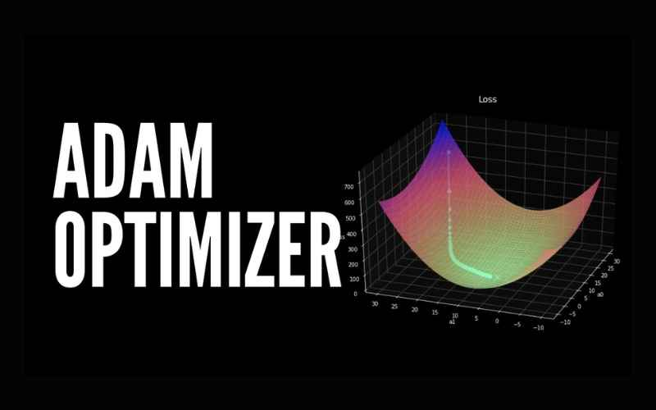
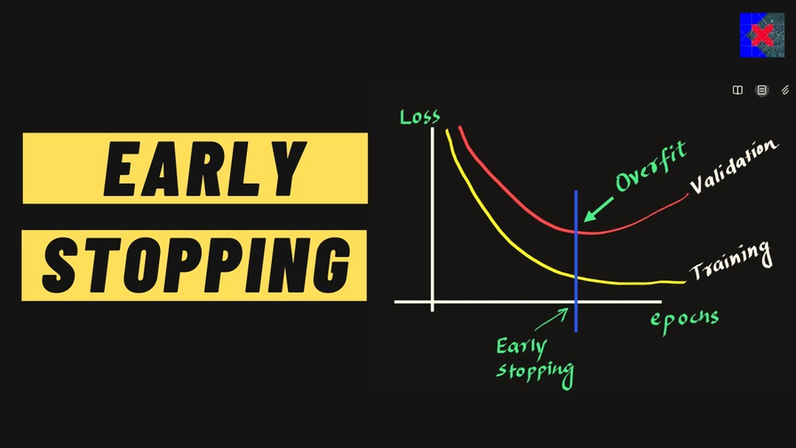
4. OPTIMIZATION TECHNIQUES
ALGORITHM LEVEL: ADAM OPTIMIZER & EARLY STOPPING
THE PROBLEM:
Standard SGD is slow to converge on sparse data. Training on synthetic data (SMOTE) carries a high risk of overfitting.
THE SOLUTION:
Replaced SGD with Adam and implemented Early Stopping.
DEFINITION:
Adam: Optimization algorithm ⟶ updates weights based on first and second moments of gradients.
Early Stopping: A regularization technique that stops training automatically when validation loss stops improving.
IMPACT:
Removes the "majority class bias," allowing the model to effectively learn the features of diabetic patients.

Slide 8
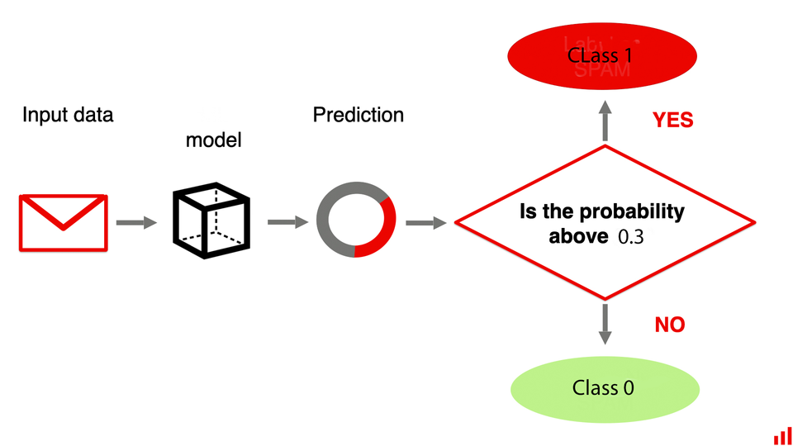
4. OPTIMIZATION TECHNIQUES
INFERENCE LEVEL: THRESHOLD TUNING
THE PROBLEM:
The default classification threshold of 0.5 treats False Positives and False Negatives equally, leading to missed diagnoses.
THE SOLUTION:
Analyzed the Precision-Recall Curve and lowered the decision threshold (e.g., to 0.3).
DEFINITION:
The process of adjusting the probability cutoff point required to classify a sample as "Positive" (At Risk).
IMPACT:
Directly maximizes Recall (Sensitivity). It prioritizes catching every potential patient, even at the cost of slightly lower precision.

Slide 9
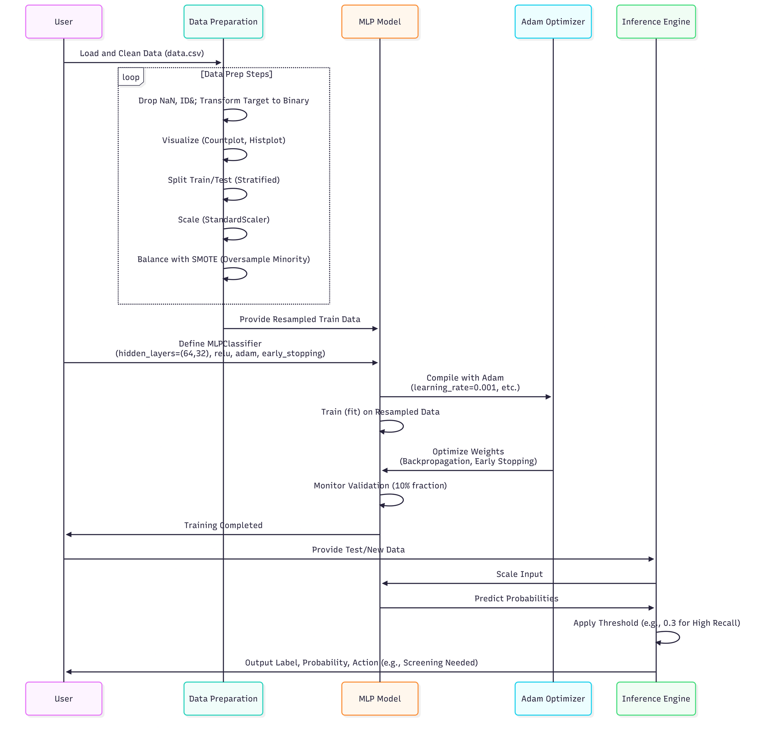
5. SPECIFY NEURAL NETWORK MODEL

Slide 10
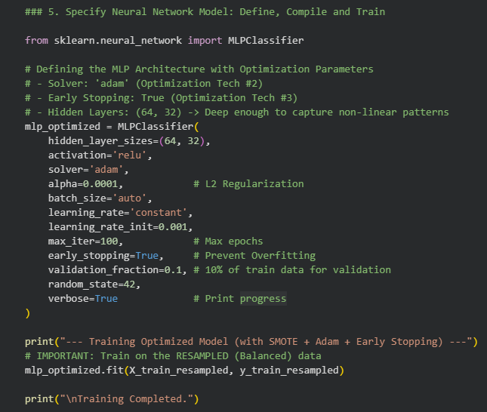
5. SPECIFY NEURAL NETWORK MODEL
ARCHITECTURE:MULTI-LAYER PERCEPTRON (MLP)
Input Layer: 21 Neurons.
Hidden Layers:
Layer 1: 64 Neurons (Activation: ReLU).
Layer 2: 32 Neurons (Activation: ReLU).
Output Layer: 1 Neuron (Activation: Sigmoid) → Probability 0 to 1.
TRAINING CONFIGURATION:
Loss Function: Binary Cross-Entropy (Log-loss).
Regularization: Early Stopping (Prevents Overfitting).
Epochs: Max 100.
KEY DEFINITIONS:
MLP (Multi-Layer Perceptron): A type of feedforward neural network with at least three layers of nodes.
Activation Function (ReLU/Sigmoid): Mathematical functions that decide if a neuron should be "fired" (activated), allowing the model to learn complex patterns.

Slide 11
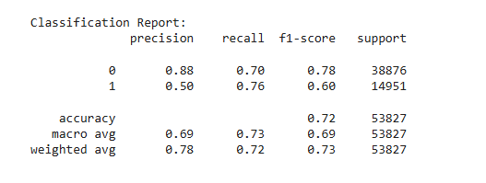
6. MEASURE THE PERFORMANCE
Baseline vs. Optimized:
Baseline: Accuracy ~86%, Recall ~20% (Missed 80% of patients).
Optimized: Accuracy ~72%, Recall ~76%.

Slide 12
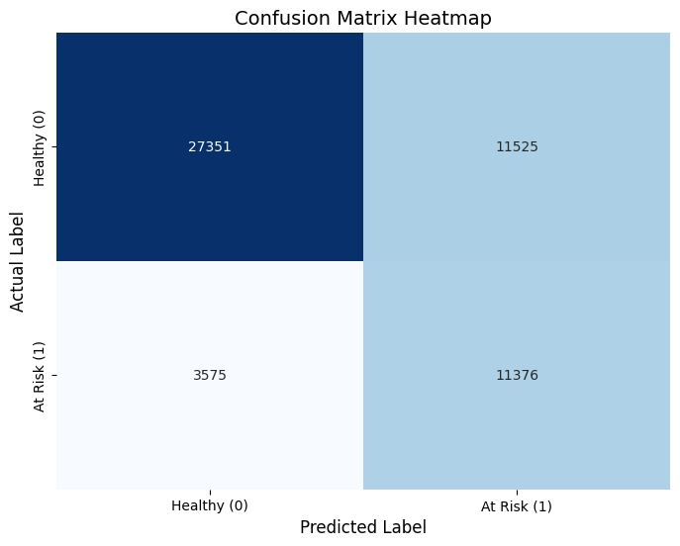
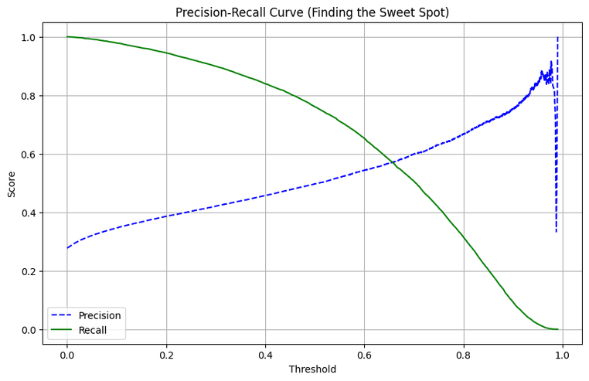
6. MEASURE THE PERFORMANCE
The Trade-off:
We accepted lower overall Accuracy (more False Positives) to gain significantly higher Recall.
Result: The model successfully flags 76% of at-risk individuals, making it medically useful.

Slide 13



7. INFERENCE ON NEW DATA
The Process:
Input Patient Data (21 features).
Scale Data (Using saved Scaler).
Model Prediction (Probability Score).
Apply Tuned Threshold: If Probability > 0.4 → Predict "At Risk".
01
Example Case:
Profile: High BMI, High BP, Age Group 10.
Result: Risk Probability 92%.
Action: Recommend Screening
02

Slide 14
8. CONCLUSION
Model & Challenge: Developed and optimized a Feedforward Neural Network (MLP) for diabetes risk prediction using a heavily imbalanced dataset (only 16% positive cases).
Robust Optimization Strategy:
Data Level: Employed Synthetic Minority Over-sampling Technique (SMOTE) to overcome inherent data bias.
Algorithmic Level: Combined Adam Optimizer and Early Stopping for stable and non-overfitting training.
Confirmed that Neural Networks, when appropriately optimized for imbalance, are powerful tools for chronic disease screening. The proposed pipeline is ready for deployment as a reliable, data-driven support system for early diagnosis and preventative care.

Slide 15

THANK YOU FOR LISTENING!

